Slide 1
Inclusion -
Webinar for Hospitality
Webinar - Presented by
Rachel Barber
Notes:
Add sponsorship logo from y & NYGH

Slide 2
Ground rules to ensure this is a safe space for all
Respect
Confidentiality
Listen
Share stories/experiences without names
Engage and repeat when asked
Microphones off when not speaking- Mute
Keep mobiles off or if needed for emergency on silence.
Notes:
If you need to doodle, fiddle etc when listening please do but put yourself on mute. We may not need this page for webinar? Use the chat box too - if I do not notice these will be answered in due course by the end. Or joseph will make me aware of them.

Slide 3
Objectives
Introduction to disability awareness
Why it matters?
How small changes can win you customers and employee loyalty.
Legislation (very brief)
Purple £ and untapped markets (introduction to)
Notes:
Add why this session is important to me. I have lived with a hearing loss all my life and have experienced direct and indirect discrimination in different places. My experiences made me more aware of others being excluded from services. This is because people do not see the person but the disability. A disabled person has aspirations, interests and skills like any of us. Therefore excluding disabled people is not only por practice but financially means you are losing money/revenue. For example, the cinema only doing captioned performances rarely and at non peak times means I don’t go nor does my friends/family. We do other things instead.

Slide 4
Exploring perceptions
I want you all to write down or draw what you immediately think/see when we say the following word: (use the chatbox or piece of paper.)
Disability
Notes:
Wheel chair, blind , learning disability- discussion on hidden disabilities eg cancer, ME, colloscemy, autism, adhd, hearing loss ( the largest group 18 million),

Slide 5
Discussion
Did the word disability come up positively or negatively?
How did the words feel?
What words did you find harder than others- and why?
Which disability came up most?
Notes:
Speak about perceptions, social model of disability, why disability is negative eg media, stories etc. This is important to cover because business are generally apathetic and unwilling to make changes until they see the negative impact it has on their business. Speak about self identify- we need to respect how people choose to self identify..

Slide 6
A few statistics -
In 2024 -
24% of the population are disabled
Less than 8% of the disabled community use a wheelchair
2% of the working age population becomes disabled every year
78% of disabled people acquire their impairment aged 16 or older
Source: Employers' Forum on Disability, DWP and government stats.
Notes:
So how would you feel that you are treated differently becoming disabled? It is hard enough facing change of any kind but it is the way we are treated that makes it even harder. We do not want pity but to be treated with respect and given the same opportunities as non disabled people. Also this means we are talking about 24% plus their families/friends as potential customers, which is something to remember when we talk about the purple £ later in this webinar.

Slide 7
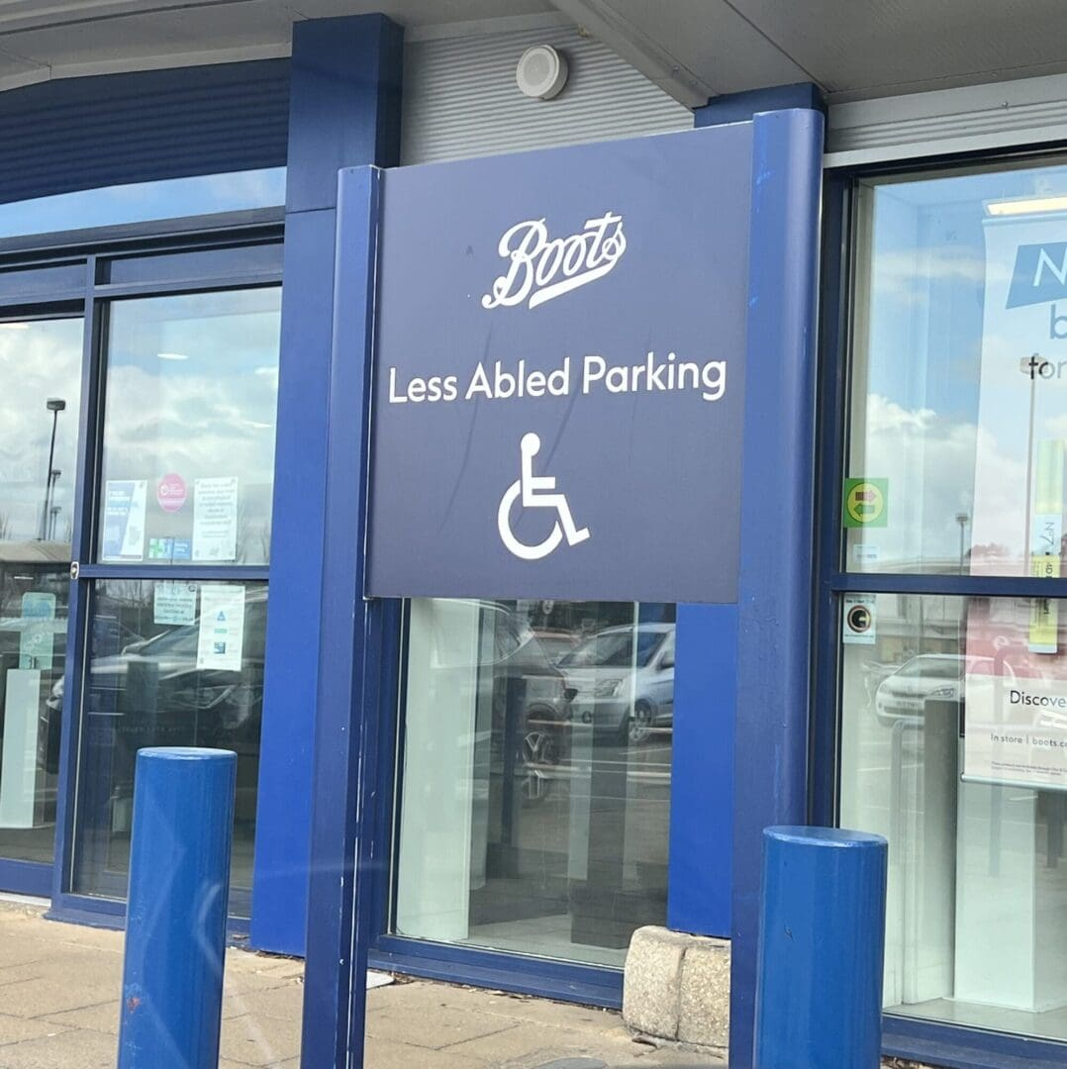

Slide 8
Language matters
Language matters.
But we rather you try and be inclusive and get it wrong sometimes. We all make mistakes.
Here is an example of where Boots got their language wrong.
This sign more than likely occurred because they were not listening and involving disabled people either as customers or employees.
What do you think the impact was to sales?
Notes:
TThis is one of the reasons why having a diverse workforce is helpful because you are less likely to make these costly mistakes. I want to stress that it is important not to be so hung about the language that you don’t employ disable people or serve disabled people as customers. Your body language and the way you interact (actions) are an important clue whether you are treating someone with the same respect as a non disabled person. For example, not looking at the disable person when they talk to you is a no no. Or giving them a different drink than ordered because you perceive they should not.

Slide 9
Perceptions- influences attitudes and behaviors.
It is often our perceptions that holds people back.
Incorrect assumptions are dangerous.
For example- “Deaf” - often people immediately assume we cannot communicate or are stupid- which robs us of opportunities in employment and in life.
Challenging perceptions is an important topic to explore in any disability awareness training. This will be explored in more detail in the workshops.
Notes:
This is making it harder for that person to do what they would like because of assumptions of safety. This is very common with people with ill health and disability.

Slide 10
Actions that make a difference for winning customers
Within Customer services these will all help towards gaining customer loyalty:
Clear information in multiple formats
Warmth and friendliness
Proactive changes that make people feel welcome
Time and understanding
Responsiveness to any concerns raised
Small changes - which make a positive impact ( example next slide)

Slide 11
Communication in any business is essential- BIG Impact
Customers will come back if you listen and respond to requests for quieter spaces.
Excessive level of noise has a negative impact on many people:
1.3 million individuals living with brain injury
700,000 individuals living with autism
Nearly 1 million people living with dementia
People living with auditory processing disorder
18 million deaf and hard of hearing people.
And even non disabled people benefit too. Because loud noise can be unpleasant and increases the risk of developing hearing loss.
Notes:
Please note there are many other examples that help the above groups which we be sharing at the full workshop. This is just one to illustrate how one action can make a big difference. Word of mouth and regular visits do happen. There is one venue that I regularly use for meetings because it is quiet. It is well used and popular filled every time I go. The acoustics are brilliant and is a pleasant space for people to relax and meet others. In training I always find so many people share how noise affects them so it is even wider than what i shared here.

Slide 12
Activity - 5 minutes
What actions have made a difference to customers?
They may be small actions but the key to the discussion are:
How did it help?
Who did it help?
What learning can you share from the examples discussed?

Slide 13
Equality Act
Protected characteristics:
Age
Disability
Gender reassignment
Sex
Civil partnership or marriage
Pregnancy & Maternity
Race
Religion or Beliefs

Slide 14
Equality Act- what does this mean for you?
By law you must make reasonable adjustments to provide access to services/goods.
You cannot discriminate someone because of a disability or perception of disability nor the people with them.
In practice for hospitality this means listening and responding to customers and employees including ones who may be avoiding your services because of barriers.
Notes:
Goin back to an earlier example, of where orders by disabled people were not responded to. This is not something that is rare. I know a lot of people whose drinks have been changed to non alcoholic because of judgements. This is discriminatory behaviour. Or kicking someone out because you think their behavior is disruptive to other customers. This happens too often to people with cerebral palsy, autism ,

Slide 15
Costs vs investment
A common reason given not to respond positively to access requests are costs.
I will rephrase this to investment.
Invest in training/talks by disabled people, who will help break down preconceptions in a safe space.
Invest in employing disabled people because this will break down misunderstandings and more. Avoiding expensive mistakes like Boots.
Invest in audits that lead to wider awareness of barriers that can be removed with investment small and large. These can be prioritised on returns.
Which brings me to the Purple Pound.
Notes:
What I said above has also been expressed very similarly by Puneet Sing Singhal: Instead of seeing disabled people as “too expensive,” what if we saw accessibility as an investment in humanity? Because that’s what it is.
An accessible world doesn’t just help disabled people—it helps everyone. Ramps are for wheelchairs, sure, but they’re also for strollers, delivery workers, and elderly parents.
Captions aren’t just for the Deaf community—they’re for anyone trying to watch a video in a loud café.
I’ve seen the power of inclusion firsthand. When you treat disabled people as equals—when you listen, support, and empower—we thrive. And when we thrive, so does everyone else.

Slide 16
Purple £ - £274 billion a year is lost to the UK economy !
In hospitality alone over £15.7 billion a year is lost to hospitality sector because of lack of access.
Over 70% of disabled customers and their friends/family do not return if the customer had a bad experience.
This adds up to the figure above.
So it makes business sense to make changes that attracts disabled customers.
For example, a friendly cafe, with staff using a range of communication methods will attract a wider group of customers.
Awareness of the impact of noise will help you to attract many more potential customers. This includes non disabled people too.
Notes:
Share cinema experience

Slide 17
Example of good practice that increase business profits
La Trappe is a brewery that makes and distribute beers. They employ disabled people in a number of different roles. Their profits increased and employee attrition rate and absenteeism had fallen to all-time lows. People don’t want to leave the company and hardly ever call in sick.
Luisa Alemany and Freek Vermuelen’s research found many other benefits with more customers wanting to come back to purchase their products, higher satisfaction from customers. It also improved teamwork leading to innovations and increased feelings of inclusion and belonging.
Notes:
Disability as a source of competitive advantage

Slide 18
Accessibility- what does this mean to you?
Accessibility is about offering everybody a warm welcome and equitable experiences. It’s about enabling people by:
Educating/supporting staff on challenging assumptions/perceptions;
Removing physical barriers where possible;
Making service adjustments to allow a wider range of people enjoy their experience.
Most changes benefit everyone. Eg a ramp/lifts can benefit non disabled people when traveling with heavy suitcases.
Notes:
At its simplest, think about four key things: ( need to ensure everyone understands equality vs equity because this is often confused.
1. Information – ensure you provide accessibility information on your website
2. Customer – ensure that staff have relevant training to serve your customers with understanding and confidence
3. Place – make low cost / no cost improvements to the built environment, amenities and services you offer.
4. Employment – become a more inclusive employer
At its simplest, think about four key things:
1. Information – ensure you provide accessibility information on your website
2. Customer – ensure that staff have relevant training to serve your customers with understanding and confidence
3. Place – make low cost / no cost improvements to the built environment, amenities and services you offer.
4. Employment – become a more inclusive employer

Slide 19
Value of checklists-
Checklists are great way of starting your journey towards inclusion.
Example include ones shared by Visit Britain and Visit England.
To harness these checklists it helps to engage with local disabled people, who can help you apply changes that help.
We help break down common misconceptions in a safe space.
For example, as a deaf person I can add a lot more small things that can make a big difference in access for deaf people.
Notes:
The checklist covers some good points but I can identify when at a venue what else would help as well as instilling confidence in staff for creating a welcoming environment.

Slide 20
Inclusion and Accessibility
Inclusion is a journey- learn from your mistakes involving disabled people on your journey. 24% of the population are disabled and this could be you at any time.
Some disabilities are temporary and others are permanent.
78% are acquired later in life.
Accessibility is EVERYBODY'S responsibility, not just one person.

Slide 21
Accessibility and Inclusion
Summary:
Inclusion is a journey.
Learn from your mistakes and involve disabled people on your journey.
Start with the quick wins- eg noise.
Suggest using a checklist to identify some of the common barriers.
24% of the population are disabled and this could be you at any time.
Not all disabilities are visible.
Accessibility is EVERYBODY'S responsibility not just one person.
It makes business sense to invest on inclusion.

Slide 22
To find out more on how you can become inclusive:
Join us at the Inclusion workshops for hospitality that have been sponsored by York & North Yorkshire Growth Hub in Selby, Northallerton and Harrogate.
These will be half day workshops providing you with more practical steps on how to be more inclusive of disabled customers. Where we will explore further on the value of the purple pound, correct language, dangers of assumptions, models of disability, effective communication techniques, other small actions that can make big changes and more.
Book here:

Slide 23
Feedback form - google form
Feedback will help shape the training in the New Year.
Thanks for attending the webinar.

Slide 24
Contact details
Rachel Barber
LinkedIn: linkedin.com/in/rachel-barber-29675b105
Email: rachel.barber@living4moments.com
Website: www.living4moments.com
Phone: 07379-433707 (whats app)

